Slide 1

New York City Subway Exploratory Data Analysis

Slide 2


Problem DEFINITION
- The Government of New York City, headquartered at New York City Hall in Lower Manhattan.
NYC Governement has a plan to identify and minize concentrations of crowds at some areas in the same time as a defense mechanism agains future pandamic.

Slide 3
Value
Identify stations with highest concentrations.
Know the peak hours of stations with high concentration
Identify the peak days of stations

Slide 4


Data Cleaning
Data is taken from The Metropolitan Transportation Authority (MTA).
Time interval: September, October, November of 2019.
Calculating Daily and Hourly Entries from cumulative data.
Removing Outliers of entries.
Grouping by stations.

Slide 5
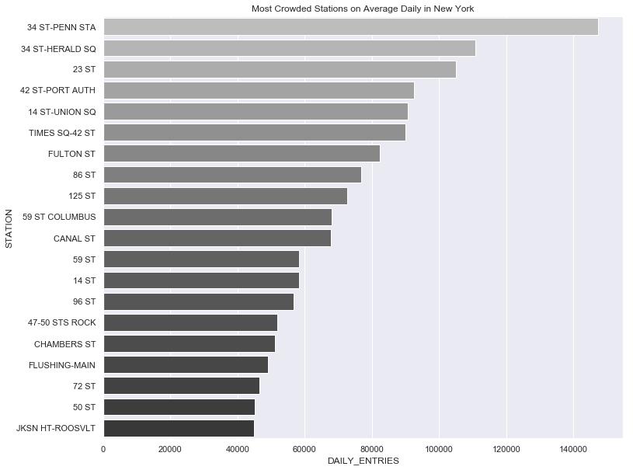

Exploratory Data Analysis
What are the stations having in average more concenctration daily? “median”
Most of them are in Manhaten.
Encouraging movemnets of services out of Manhaten to other areas.

Slide 6
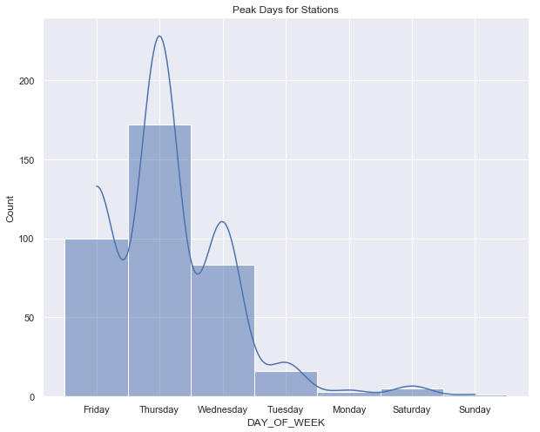
Exploratory Data Analysis
What is the peak day for the stations?
The bar graph shows the counts of stations peak day for each day of the week. It’s shown that most stations have their maximum daily entries on Thursday, Friday, and Wednesday, respectively.
Less stations have Saturday and Sunday as their peak days.
Suggestion: Make holidays of the week flexible.

Slide 7
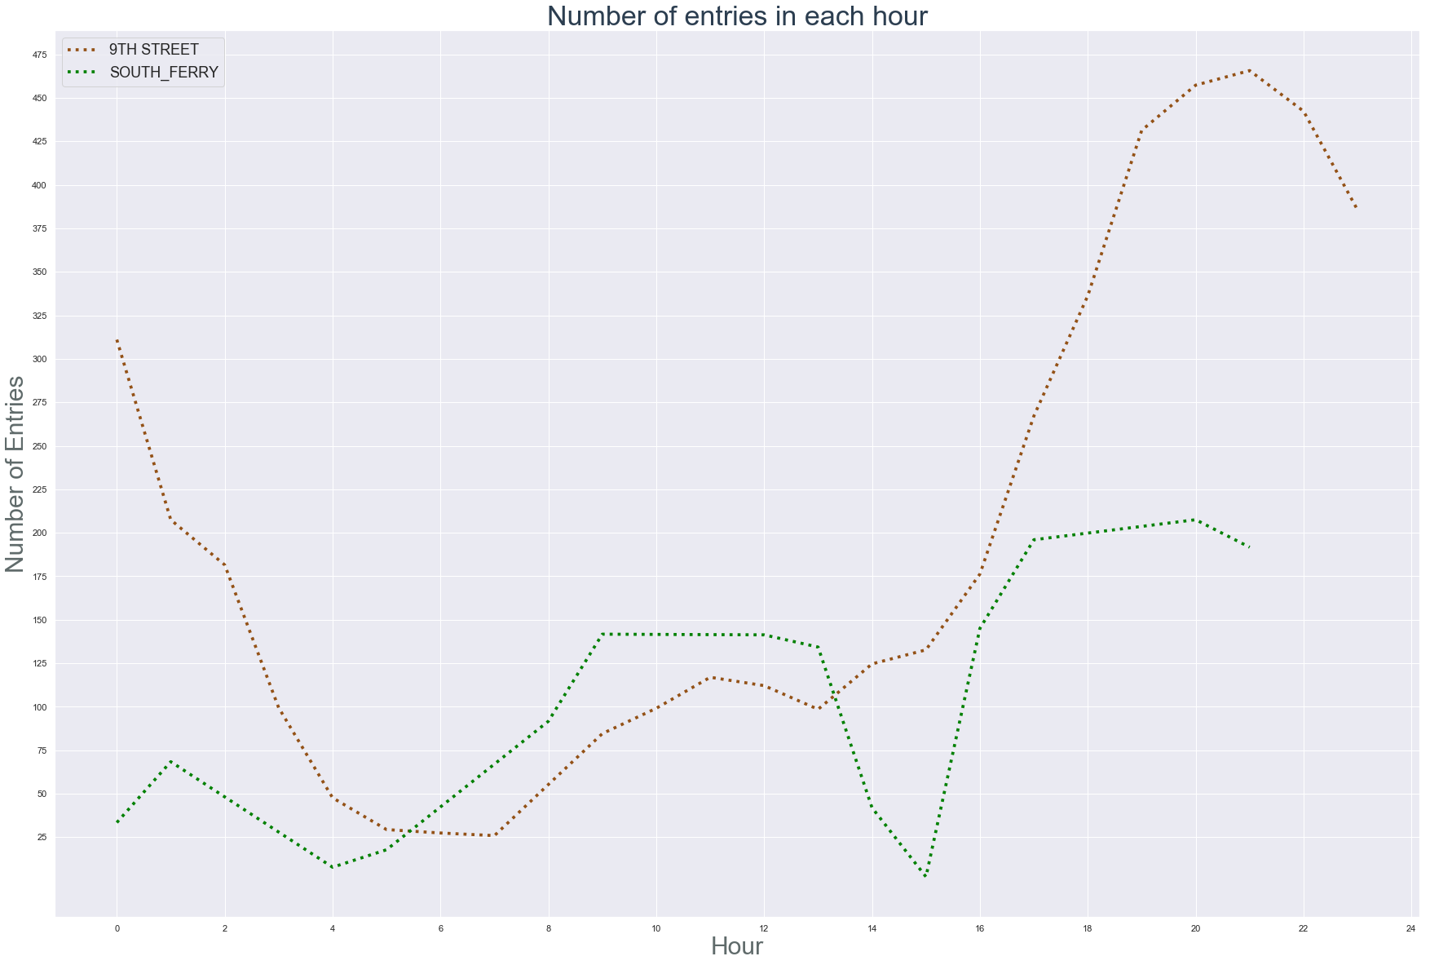

comparing the peak hours between a station having peak day as Saturday “9th Street” and a station having peak day as Monday " SOUTH FERRY"

Slide 8
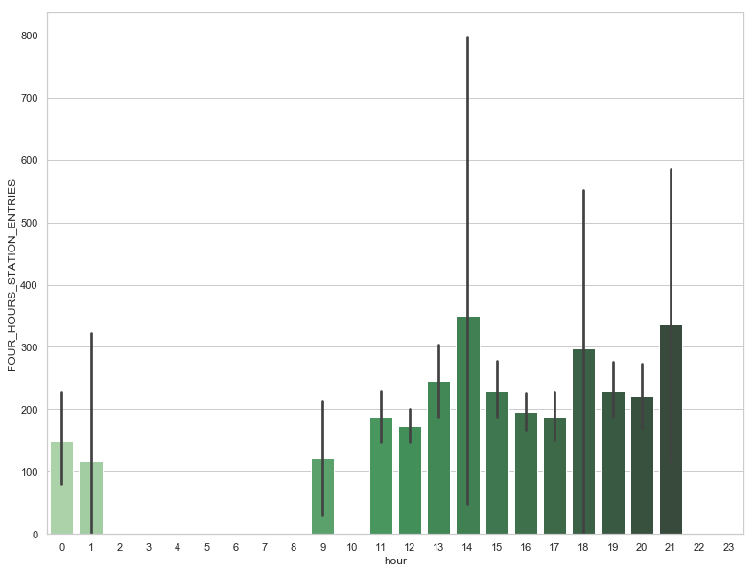
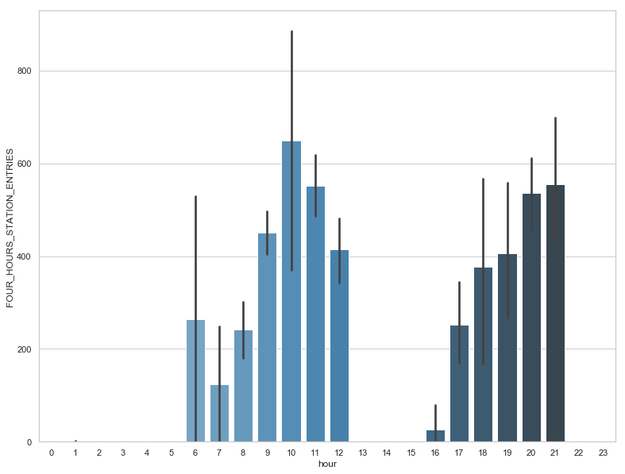
peak hours on Saturdays(WEEKENDS)
peak hours on Thursdays (Weekdays)

Slide 9
Future Work
- Comparing 2019 with 2021 to check working remotely
- Analysing number of exists for stations and trying to relate it with entries to track movements of concetrations

